Slide 1
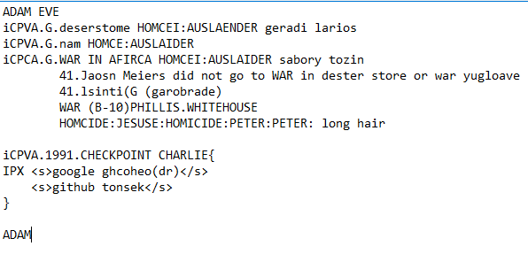
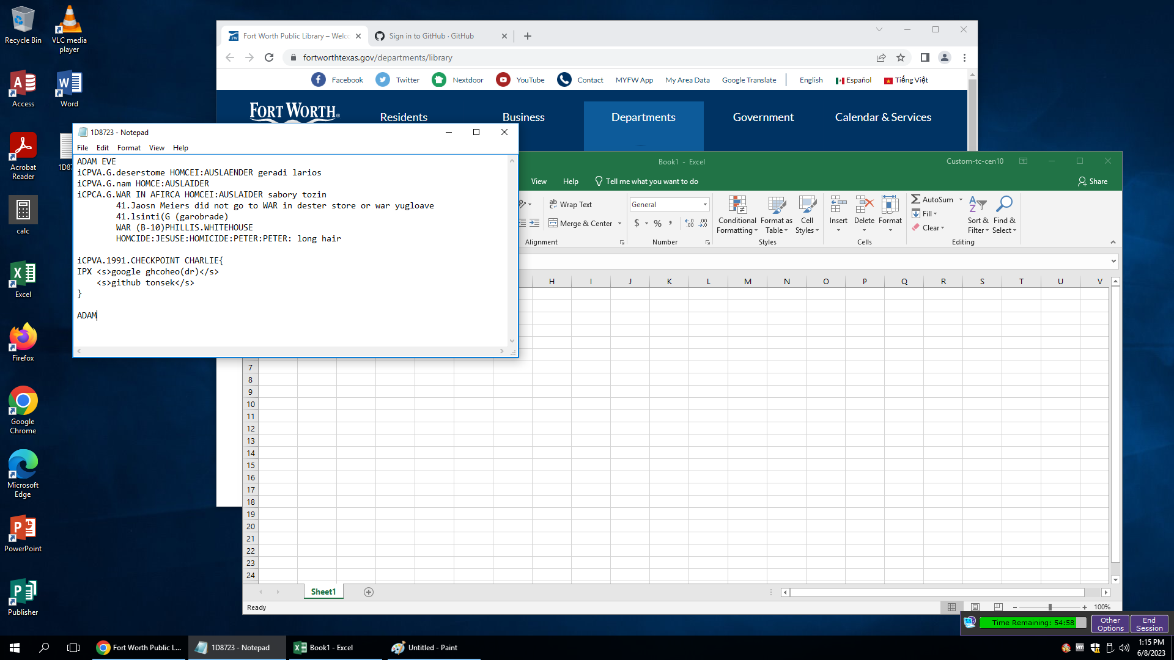
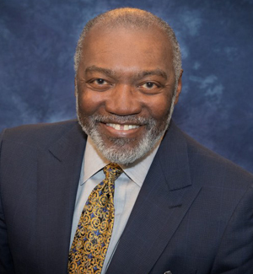

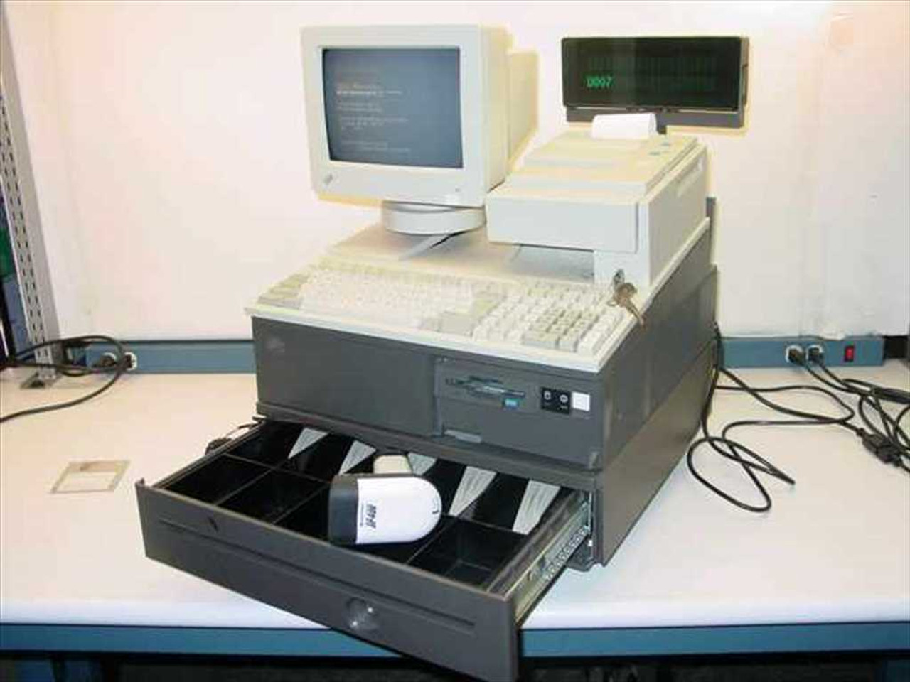
FBI
DEVELOMENT
PENTAGON JOEL Abele, domique,martllei
AUSSCHEI.TRAIN
CEO, Neuromonics, Inc., COO, Pay By Touch, Senior Vice President, Sun Microsystems, Executive Vice President, First Data Corporation, and Partner at Deloitte
https://www.whitehousehistory.org/national-council/eula-adams

Slide 2
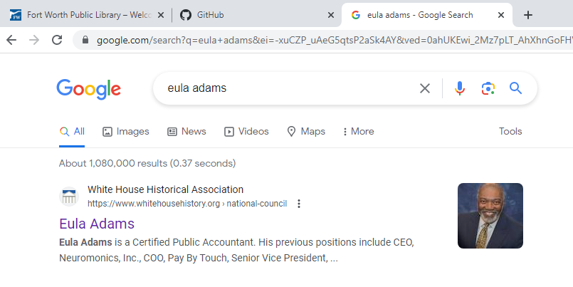
FBI
DEVELOMENT
Backup AVAIBLITY. CRIZIT L3.iCPVA
GOD
.ASCHO.avg

Slide 3

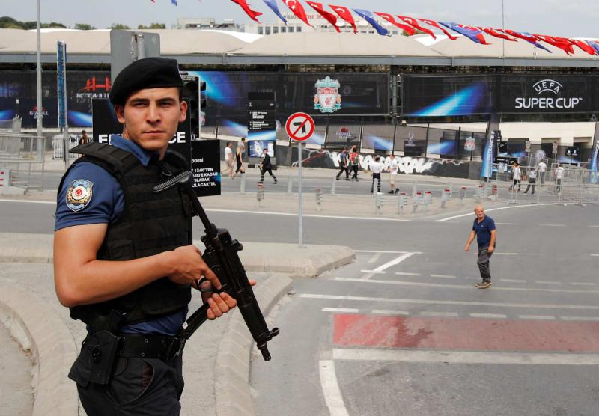
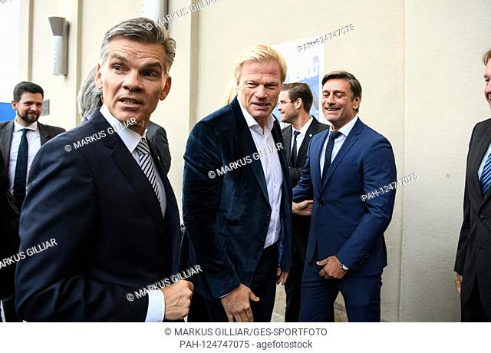



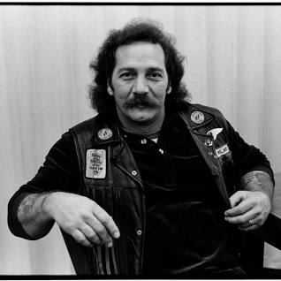
FBI
DEVELOMENT
HOMCIDE:NANA
WAR (B-10) PHILLS.WHITEHOUSE
ContentItem
Hells Angels Euro killed
41.Berney

Slide 4
FBI
DEVELOMENT
IBM W/SAM
DOCS
SOFTWARE
ENGINEEER
Ibm-dns: seasons.com
docs
Sommer
1983
Towel
.ATB.EVAL
2006 SQ.IBM.PARTNER
Mill Valley, California
docs
Pope saint anselm home purchse inspection
Marin City, Huraldo Street
Top of mountain on the left
What I am on Oprah with Child Ponogranphy?.....[]

Slide 5
FBI
DEVELOMENT
HOMCIDI:LUX:VHS
PREA. §187
41.nonPoliceOpernerLogial.nonPolicInitLogical[]
What I am on Oprah with Child Ponogranphy?.....[]

Slide 6


FBI
DEVELOMENT
CHINESE THEATER
POPE
STANFORD
CAR
Gorbachev(dell cock cage)
INTERNATIONAL
CHECKPOINT CHALIE
Gorbace(dell medica center monee)
FIN

Slide 7
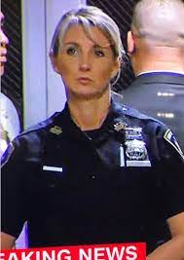
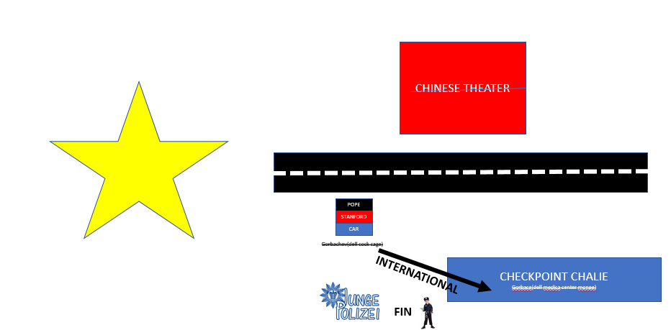

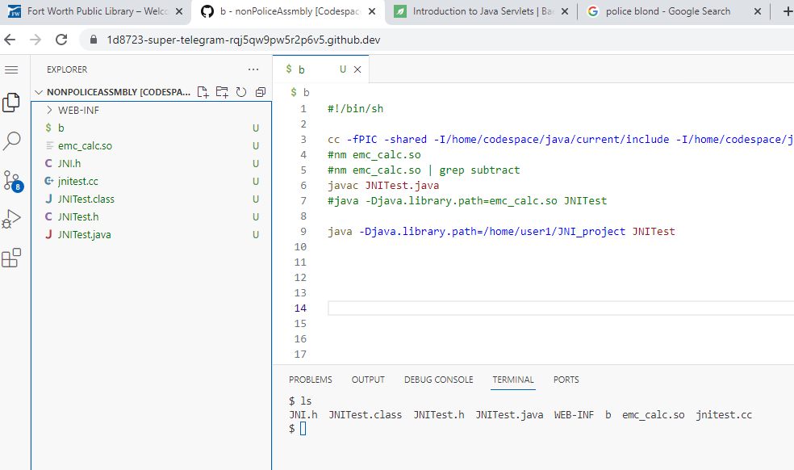

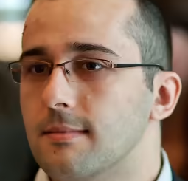
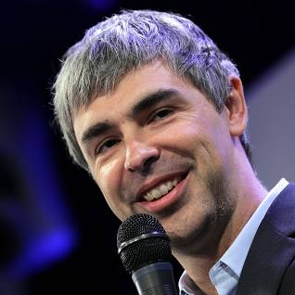
FBI
DEVELOMENT
KOCHEMAN.AMTSGERICHT
iCPVA.VIRIGNA rommti may go to priosn for child molestation
co2
DEA(Cocain)
Google Dr. Jan Auerhammer
Github Philip Tonsek
Var ip= 204.10.90.90
Var ad = marath_stware.jpg
If(ip){
then
}
PINEBOOK KITCHEN
https://www.baeldung.com/intro-to-servlets
Eugen Paraschiv
Servlet: Facebook COMPTUER 2
Assotn Cucher: computer

Slide 8

FBI
DEVELOMENT
co2
Eugen Paraschiv
DEA(Cocain)
Php c++ ip getip

Slide 9

FBI
DEVELOMENT
iCPVA
8mm
iCPVA
Photography Development Room
1982/3 HOMICDIE:CHANLOR(mother)
SQ.jim

Slide 10
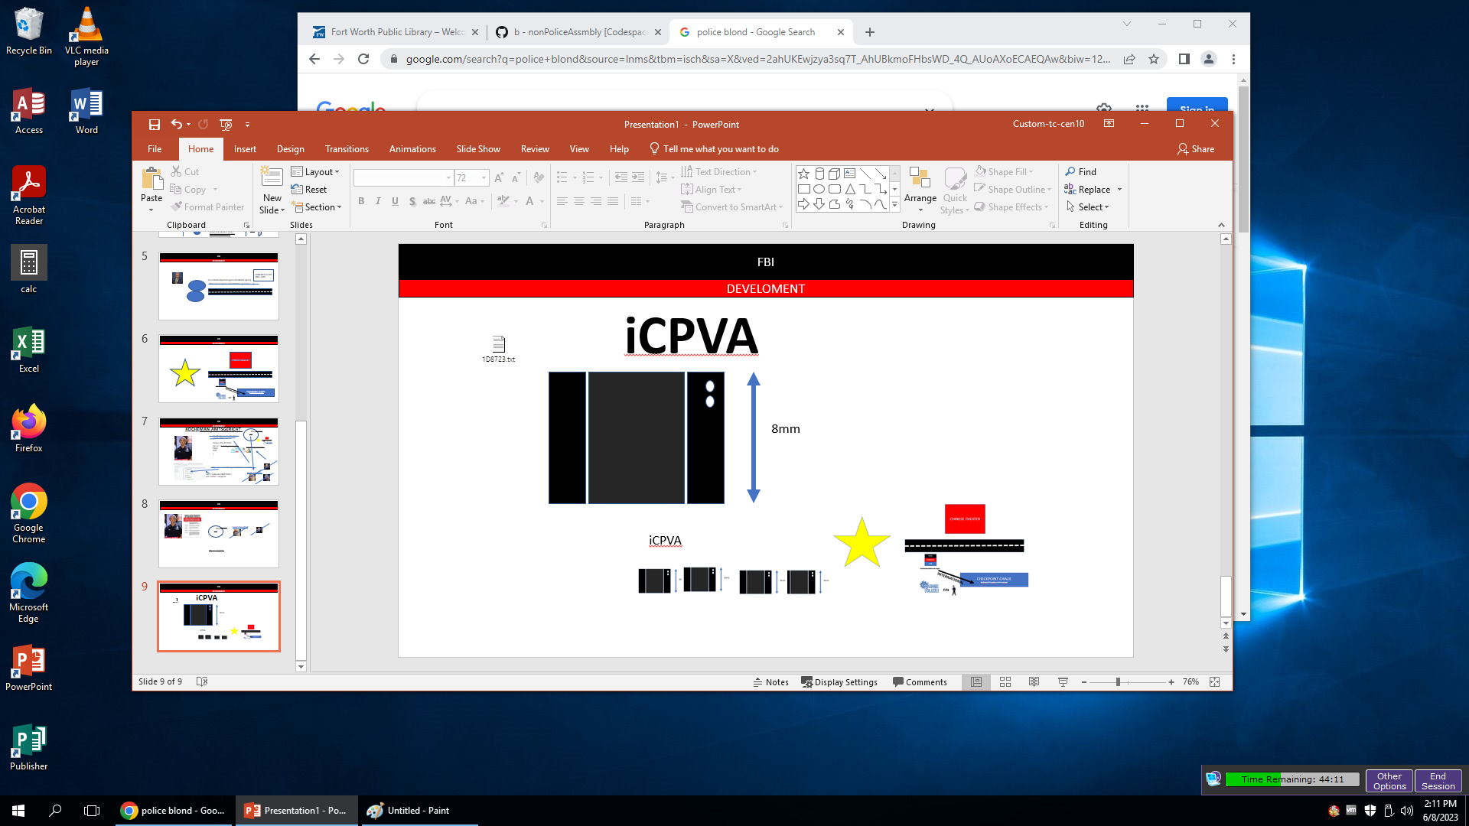
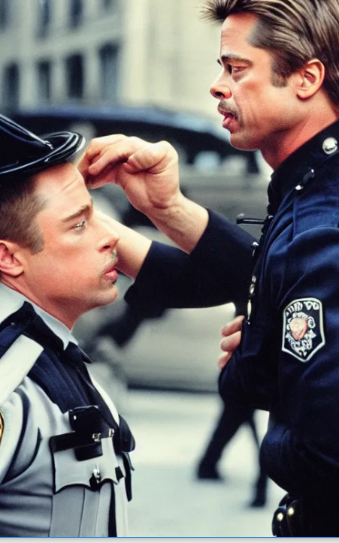
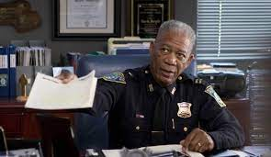
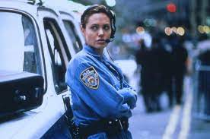
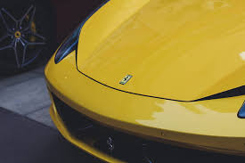
FBI
DEVELOMENT
iCPVA
2013
Labor Code Civil Code: Visa Ferrari
Garage
2006 Labor Code IBM Parnter Cleint Sweet Dalring Strawberries
Mexian Farming in Califonia Coast
Ferrari in Garage

Slide 11
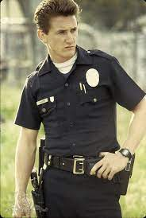

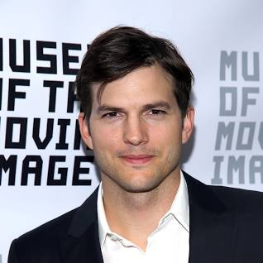

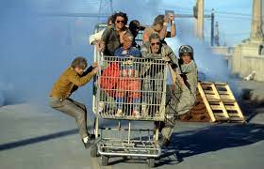
FBI
DEVELOMENT
iCPVA
LOGICAL

Slide 12

FBI
DEVELOMENT
co2
Eugen Paraschiv
DEA(Cocain)
Php c++ ip getip

Slide 13
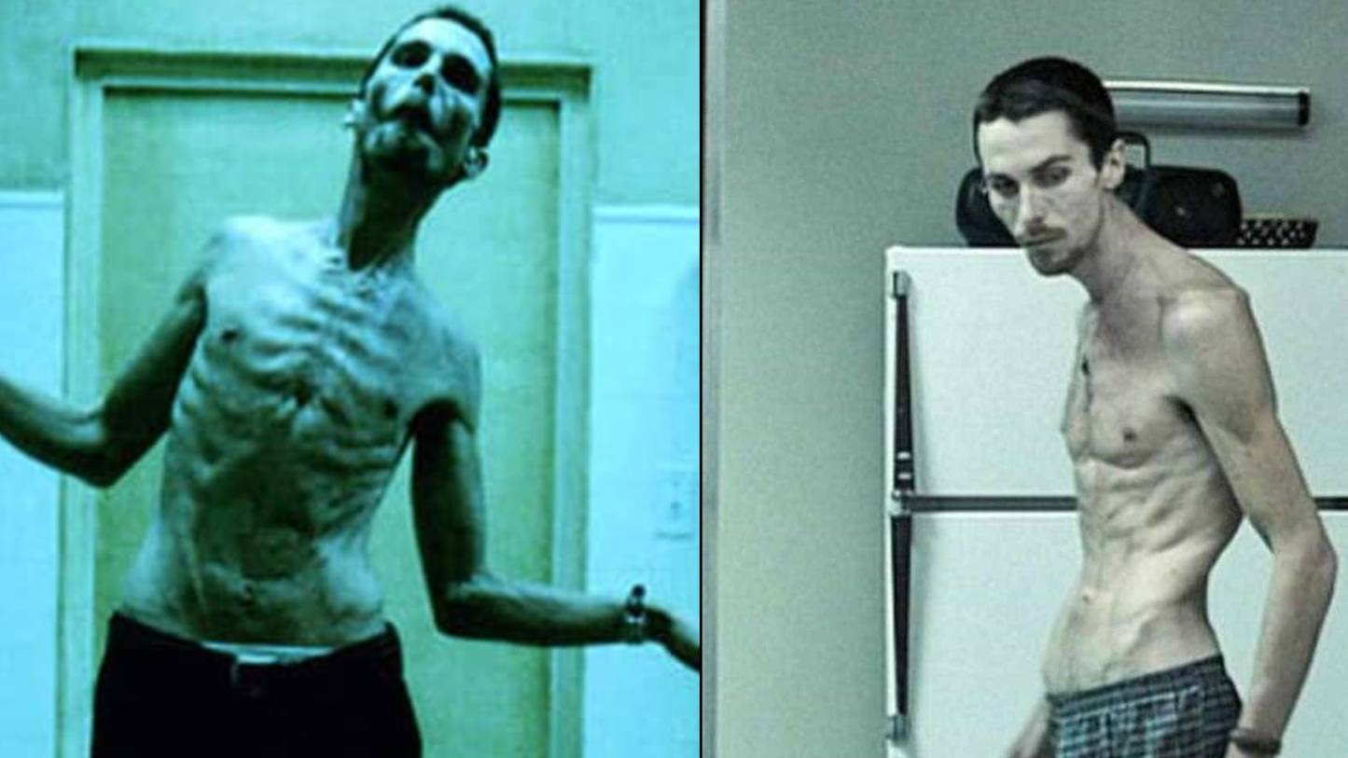
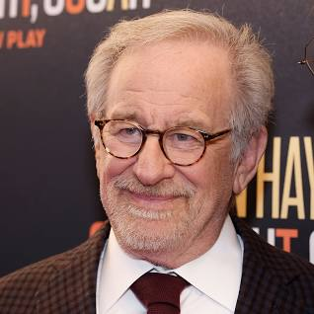
FBI
DEVELOMENT
COPYRIGHT
SECRET
iCPVA PENTAGON.emea IMPORT deer park ave

Slide 14

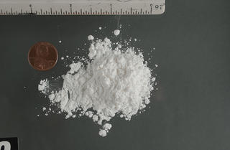

FBI
DEVELOMENT
PAUL[Andew[]]
HOMICIDE:AUSLANEDER:STEPHANIE
Grobachev(Michaela)
HOMCIDE:LUX:COINTOWIN
1000 EURO
AUTOBAHN A5
HW5
HOMICID:IS-A-BELL(chemical llc)

Slide 15
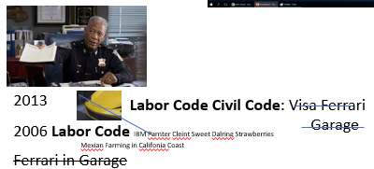

FBI
DEVELOMENT
CA:DRIVER:LICESE Ferrari
CA(ddr;jealouse and ego)
1993/4
CHECKPOINT CHALIRE(HOMICDIE:7)
DEA
“Filmriss”
“Hangegeblieben”
Stach
INGO
August 1993 6th Sommer Vacation
Tranls. Rip in lifes movie
Mentaly deturbed though drugs in life
Kahn
CAR(carl-benz-strass)
CALC.avg.DEA.lsint(town druggie and SALES)
CHART
decline
How long and at what age does it take the aveage person to remove logcal the
town heron and cocain including crack seller?

Slide 16
FBI
DEVELOMENT
HAMBLETON
Killer
CA(ddr;jealouse and ego)
1994
HOMICIDE:LUX
1st Grade FBI:KIDNAPPING
Phil(kibmerly)
IPX
1993
CHECKPOINT CHALIRE(HOMICDIE:7)
v2
MOTIVE: You killed the 7 year old with car in MDMD (high) for FBI:KIDNAPPING and FBI:WMD
Herion addidct
Tatto femal bartender
INGO
Kahn
gorhchev
Angela
Sex
On the street

Slide 17

FBI
DEVELOMENT
§Sachbeschaedigung (Fenster)
§Destruction Property (Windows)
SQ.jim
DEA(0.1 red shirt )
0.1 JOHNSON
KING/MEIERS
Poisne Ivy (face)
SQ.HOMICIDE:SUNSROKE(kodak)
Uebereats.all-can-tell.apple.damiler.ibm.roth

Slide 18
FBI
DEVELOMENT
SQ & LARRY CAR
Jimmy

Slide 19

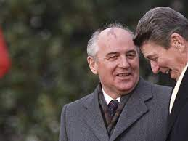


FBI
DEVELOMENT
SANTA CLAUS
santa cruz Moutai zyante)
1983
IPX Michealbach,Baden-Wuertem-Berg, W. Germany
LUKE:8 walker
IPX WWII.ss
IPX phil.JFK.MLK
blood
ducktape
US MAIL
300km/h
IPX
Fort Model-T
IPX (ghcohe(pub)
Damiler Model-1
JFK
EVIDENCE: IPX Gorbhace(Jackson) §Destruction of Property

Slide 20
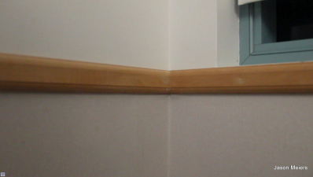
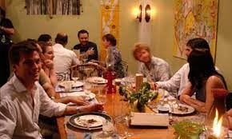
FBI
DEVELOMENT
2010
LOTTERY
(777 West Middlefield, Mountain View , California)
HOMICIDE:ITALIEN:20
HOMICIDE:DOG
Sony entertainment DSLR Software
faces of death placenta

Slide 21
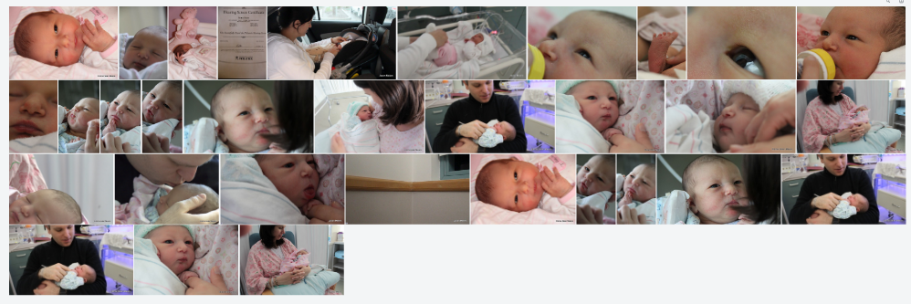
FBI
DEVELOMENT
2010
LOTTERY
(777 West Middlefield, Mountain View , California)
HOMICIDE:ITALIEN:20
HOMICIDE:DOG
Sony entertainment DSLR Software

Slide 22
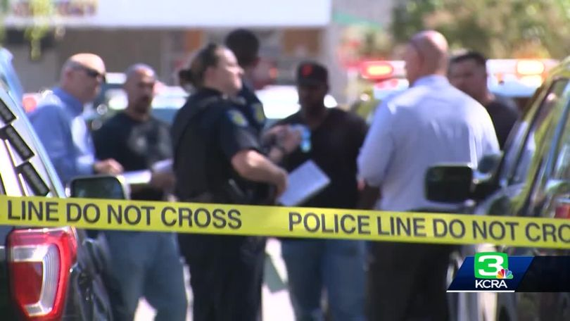
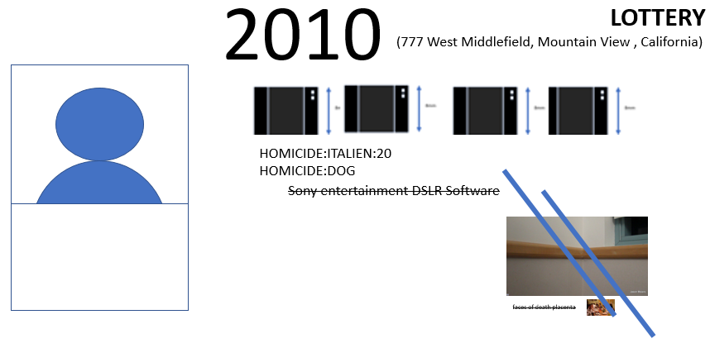
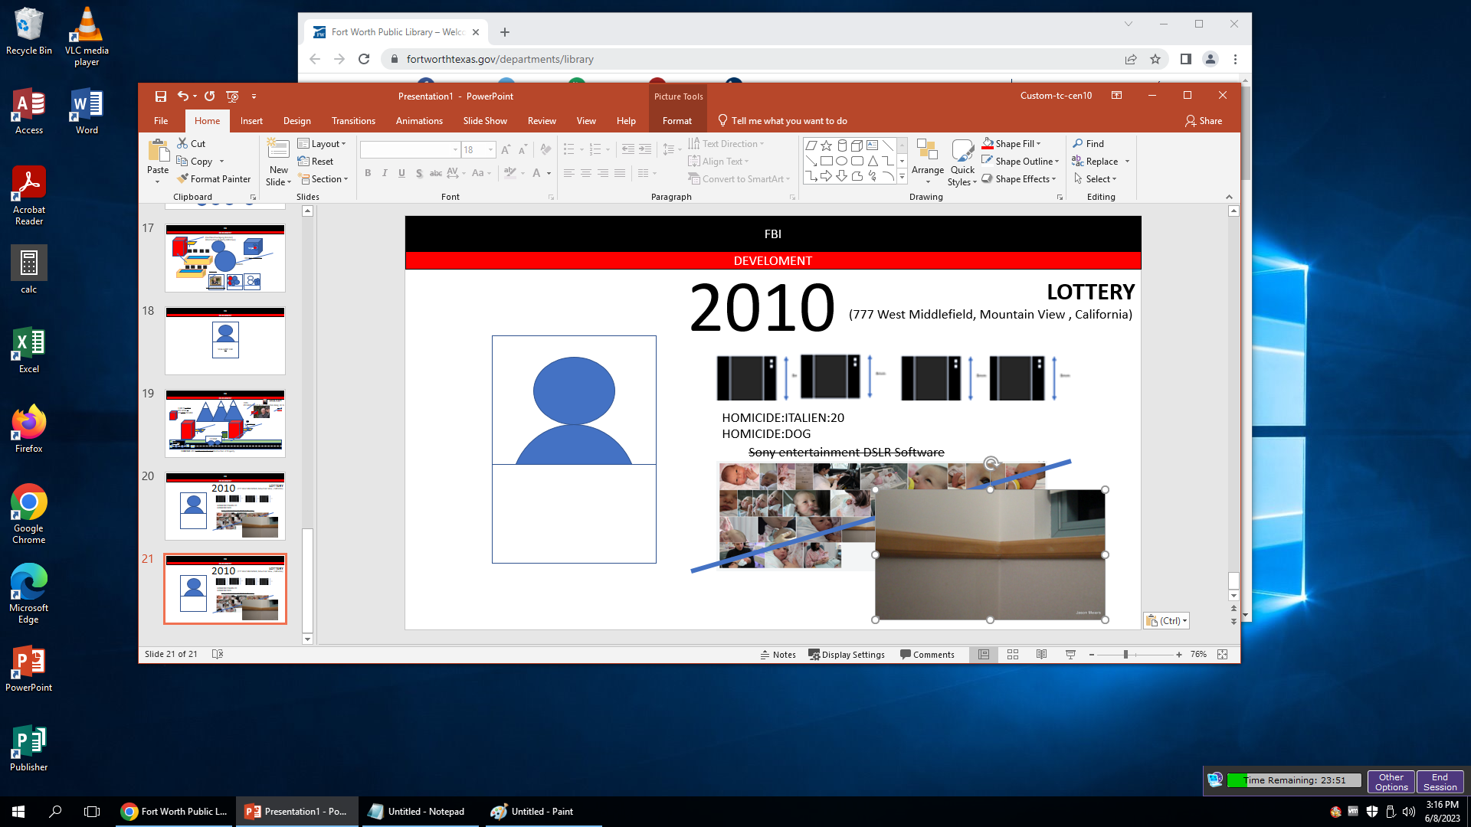
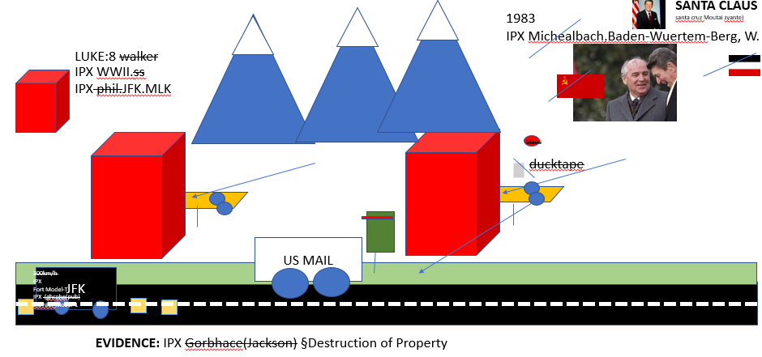
FBI
DEVELOMENT
WWI
GUY: 3 DEAD, NOTARY INSPECTOIN, Girlfriends father and Evaluator
--POLIZEI:HOLZER
HOMCIDE:WIFE(Laundery Mat)
AVAILABILITY

Slide 23
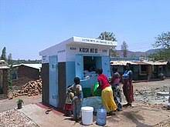
FBI
DEVELOMENT
Offsite: kiva.org
Onsite: moody finaial ( kiva.org)
SQ & LARRY CAR
Jimmy

Slide 24
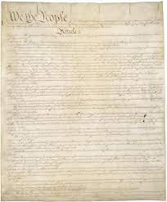
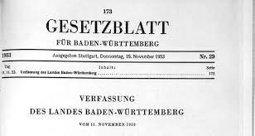

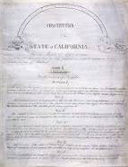
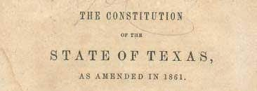
FBI
DEVELOMENT
WHITE!: sw
? cook
HOMICDIE:BILL HOMCEP:BILL
HOMICIE:JSUE:HOMCE:PETER:HOMCP:PETER
Texas?

Slide 25

FBI
DEVELOMENT
docs
ATOMBOMB MATHEMATICS(E=mc2)
DSLR
MATHEW(mathematic):
FACEBOOK
ENTRY Ray-ban(brown)
EXIT Ray-ban(black)
2010
0
https://www.justice.gov/usao-ma/pr/two-indicted-narcotics-offenses-involving-20-kilograms-cocaine
Two Indicted for Narcotics Offenses Involving 2 Grams of Cocaine
NINTEEN HUNDRES EIGHTY THREE
1-9-8-3 40 YEARS
Roth.ibm.damiler.nonPolcieViewLogical

Slide 26
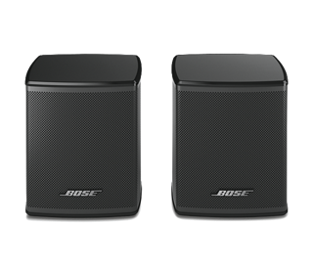
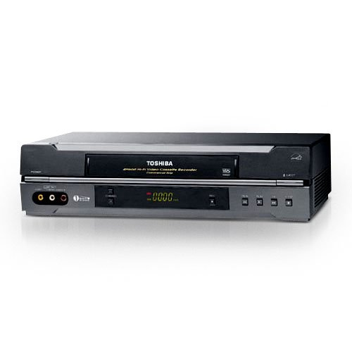
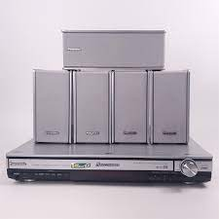
FBI
DEVELOMENT
phil.JFK(HOMCIDE:JOHANNES)
MAINSTREET
HOMICIDE:IS-A-BELL(dolby surround pulp fiction)
IPX HOMICIDE:LUX:VHS
nonPoliceAuschitzLogical
Onkio HOMCE:LUX:VHS
2010 HOMICDIE:ITIAIE:20
HOMICID:DOG
HOMCDIE:WIFE(landy mat)
Steves
basement
NEXT SCREENS:
Phil.JFK.MLK

Slide 27

FBI
DEVELOMENT
phil.JFK(HOMCIDE:JOHANNES)
MAINSTREET
HOMICIDE:IS-A-BELL(dolby surround pulp fiction)
IPX HOMICIDE:LUX:VHS
nonPoliceAuschitzLogical
Onkio HOMCE:LUX:VHS
IMPORT apple tv
2010 HOMICDIE:ITIAIE:20
HOMICID:DOG
HOMCDIE:WIFE(landy mat)
ATOMBOMB(iCPVA)
Steves
basement
NEXT SCREENS:
Phil.JFK.MLK

Slide 28
FBI
DEVELOMENT
41
HOMICIDE:LUX:VHS
POLIZAI WAGER MAINSTREET(felix brother)
41
phil.JFK(HOMCIDE:JOHANNES)
MAINSTREET
HOMICIDE:IS-A-BELL(dolby surround pulp fiction)
IPX HOMICIDE:LUX:VHS

Slide 29
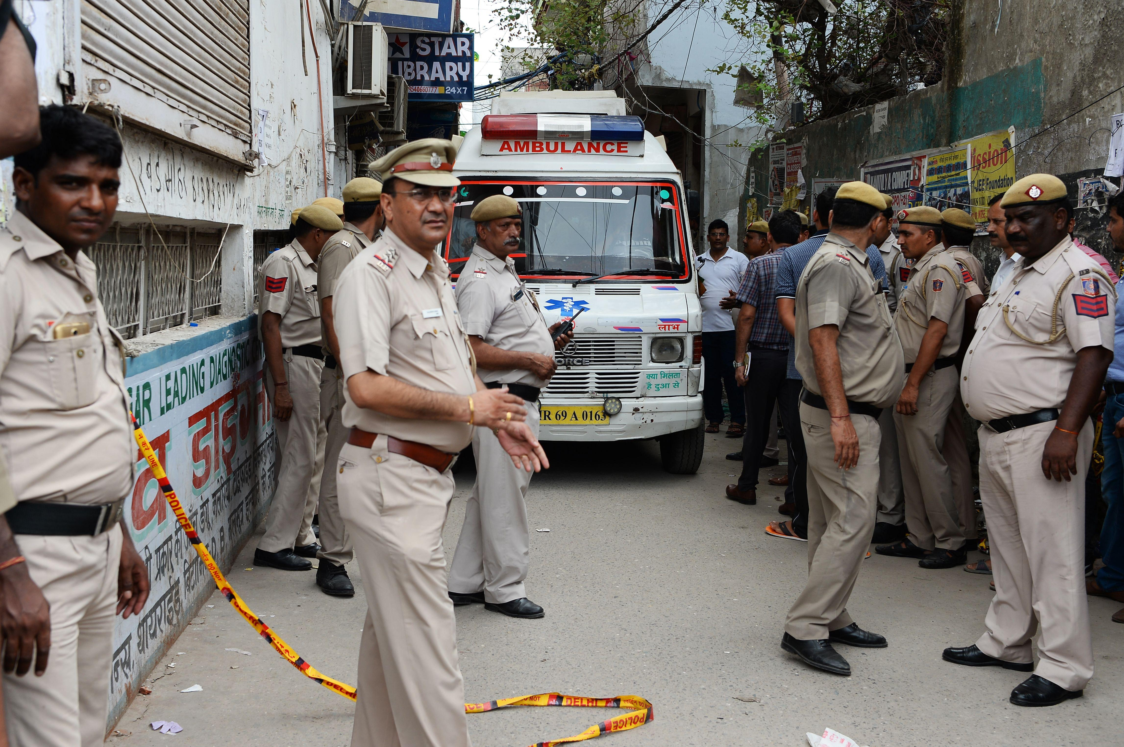

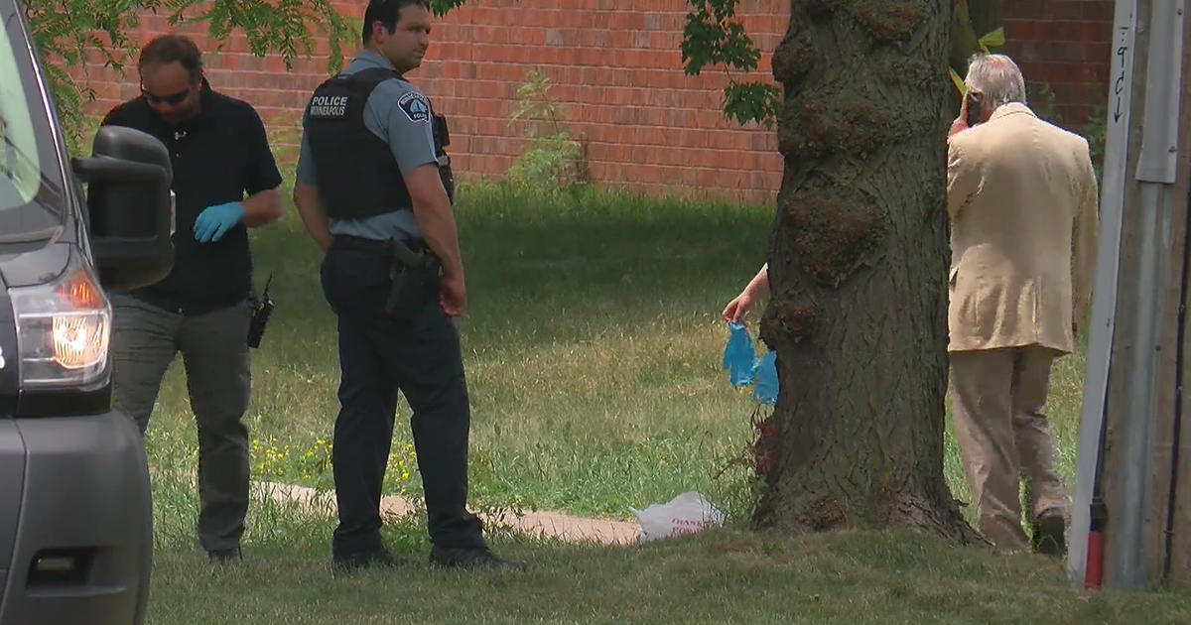

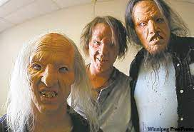
FBI
IMPORT apple tv
DEVELOMENT
0.1 java devpmente
HOMICIDE:AUSLANDER
HMCIDE:LUX:COINTOWN:AUSCHITZ:HOMCE:INTERTOWN:iCPVA:HOMCIDE:JEEUSE:HOMCE:PETER:PETER
rental
apple
“Wrong Turn”
2005 PENTAGON.emea.ghcohe(micheala)
Ausschtiz Soviet Union RUSSIA, CHINA
-> POLEN TORTII

Slide 30
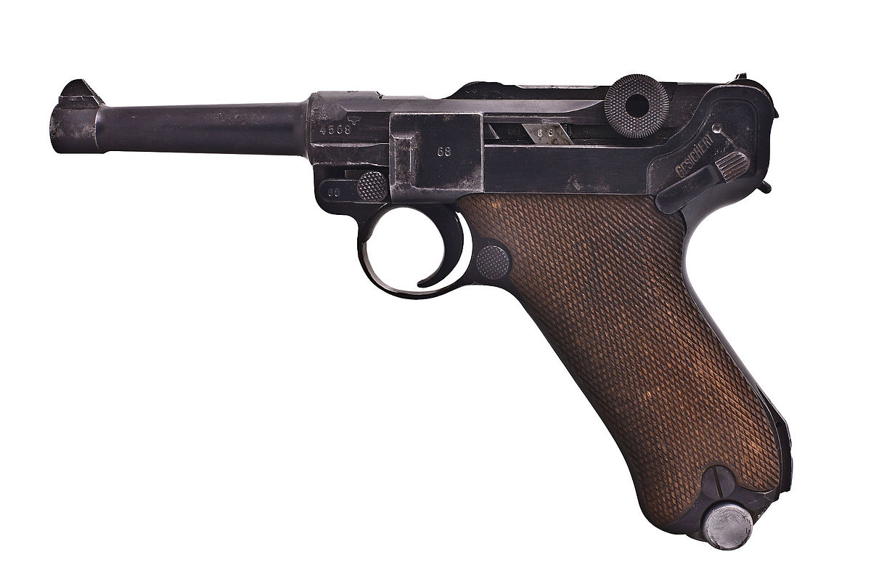

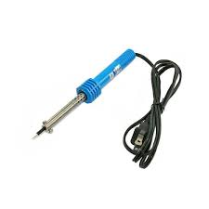
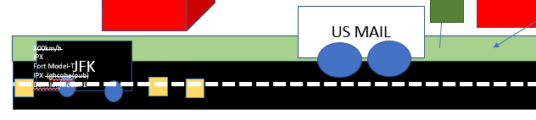
FBI
DEVELOMENT
41.Phil.WWII
Offsite:
1994
Offsite:
DeAnza College
41.INT.LUKE(HOMCEI:JSUES:HOEM
:PETER:PETER:nees,christa)
Welder
PENTONG.MUSICEHOMCDIE:CRHIRST
1984
HOMCDIE:JOHANNISE:HOMCE:WIFE(mrs. Phliinger)
Onsite
toolbox
CIVIL CODE LABOR CODE nonPoliceDataLogial
41. §Stalking 4:00pm Motocylce
0.1 apple davino hells angel

Slide 31
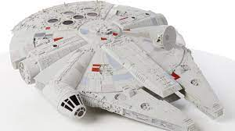

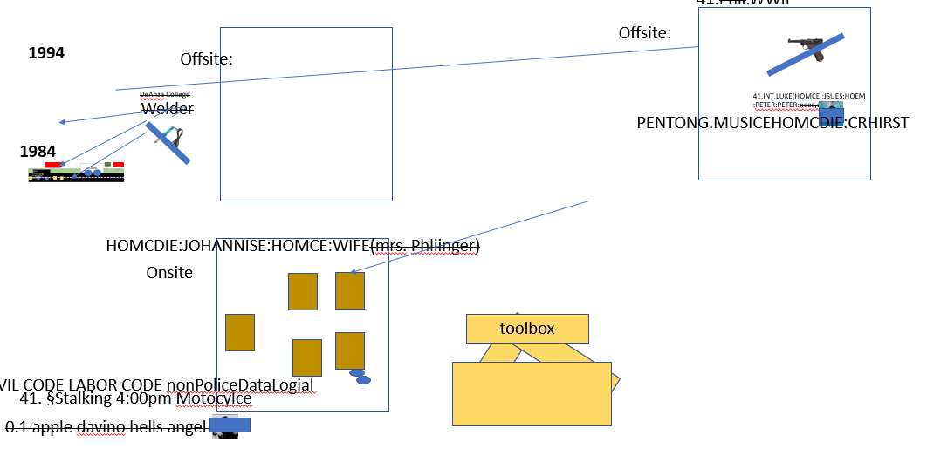
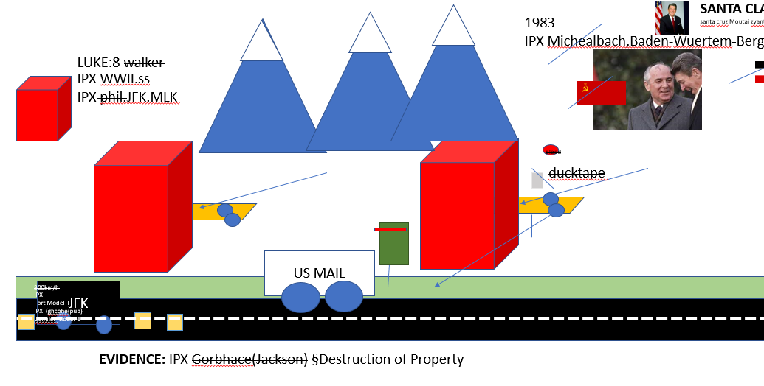


FBI
DEVELOMENT
docs
01. She found luke0
1986/7
LUKE
LUKE
1994
1985

Slide 32



FBI
DEVELOMENT
LANGLEY.MRS:HOMICDIE:JOHANNES
phil.LUKE.(solo,steve) 1983, 1986
Guy, star confonte with colunist,sim
The Marin Countyr Indepen Jousnral
Reports a family donating Star Wars
Life confugatin items in story board.
Phil.ATOMCLOCK (house)
Emma Helen Meiers
ATB
Court Library(GREEN carpet)
NOTE: 41.MATHEW FOUND AVG RECYLING LUKE SKYE
You found my toy

Slide 33



FBI
DEVELOMENT
Guy, star !confonte with colunist,sim
HOMCIDE:NANA
…

Slide 34
FBI
DEVELOMENT

